Slide 1

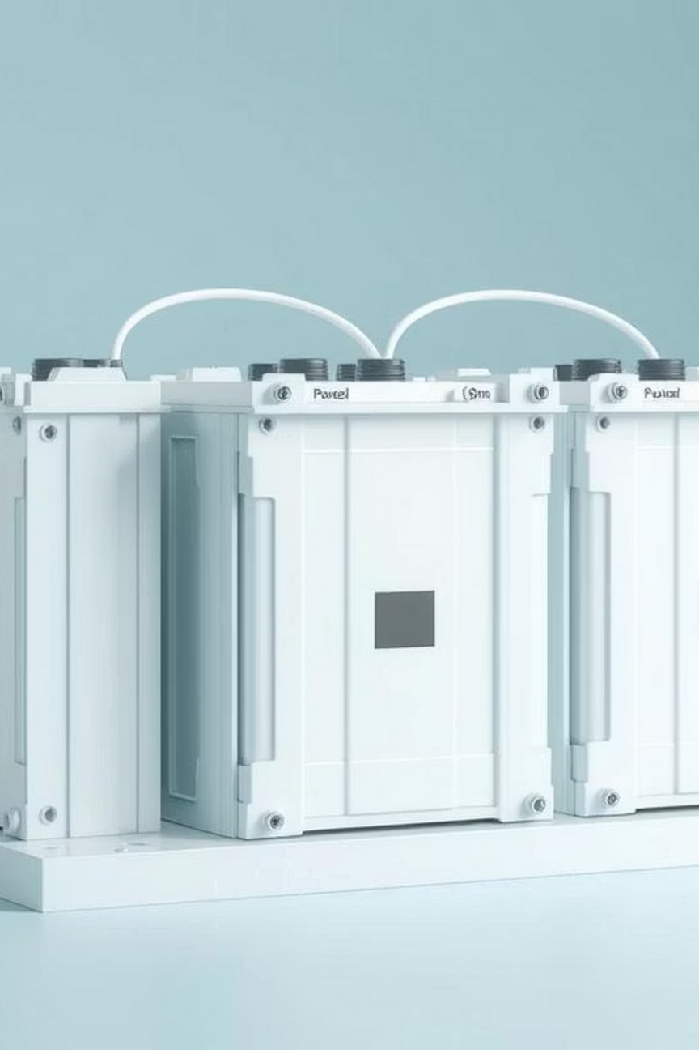

Battery Pack Modeling and Thermal Simulation
This report details our progress on modeling battery packs and simulating their thermal behavior using Simscape Battery Toolbox. We'll cover the workflow from cell to full pack, thermal considerations, and initial simulation results.

Slide 2
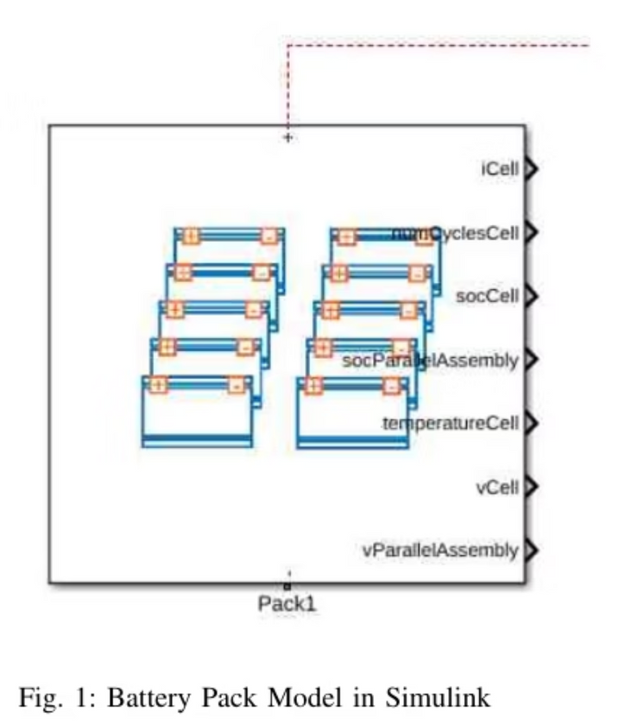
Project Objective
1
Battery Pack Modeling
Develop a detailed and scalable battery pack model using Simscape Battery Toolbox.
2
Thermal Port Implementation
Integrate thermal observation ports to monitor temperature at critical points within the pack.
3
Thermal Simulation
Simulate heat generation and analyze temperature distribution and rise under various load conditions.

Slide 3
Battery Pack Modeling Workflow
1. Pouch Cell Geometry
Define the physical dimensions and characteristics of a single pouch cell.
2. Parallel Assembly
Combine multiple pouch cells in parallel to achieve desired current capacity.
3. Module Construction
Build battery modules from series-connected parallel assemblies.
4. Full Battery Pack Assembly
Assemble the complete battery pack from multiple modules.
5. Thermal Simulation
Enable thermal modeling and simulate heat flow and temperature changes.

Slide 4
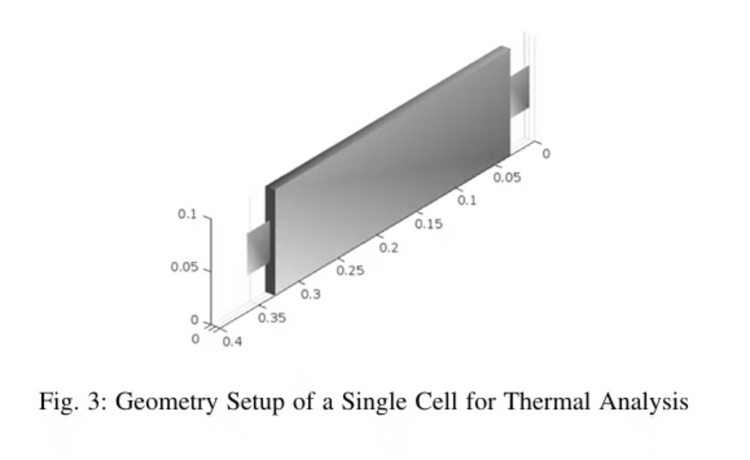
Pouch Cell Configuration
Physical Design
The 'batteryPouchGeometry' function was utilized to precisely define the physical parameters and dimensions of the pouch cell.
Thermal Integration
A dedicated thermal port was enabled within the cell model to allow for accurate temperature observation and data acquisition during simulations.
Visual Validation
The 'batteryChart' function provided a clear visual representation, confirming the geometric accuracy and configuration of the pouch cell.

Slide 5
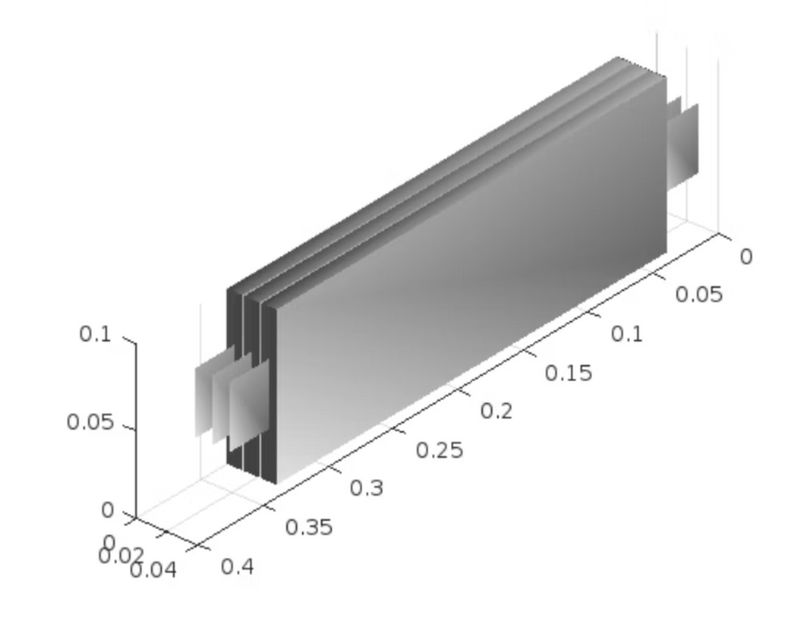
Parallel Assembly
1
Configuration
Three individual pouch cells were configured in a parallel arrangement to increase the overall current capacity of the unit.
2
Function Utilization
The 'batteryParallelAssembly' function was instrumental in defining the electrical and physical connections between the parallel cells.
3
Structural Validation
Visual inspection via 'batteryChart' ensured the assembly's geometric integrity and proper alignment of components.
fig.2 parallel assembly

Slide 6
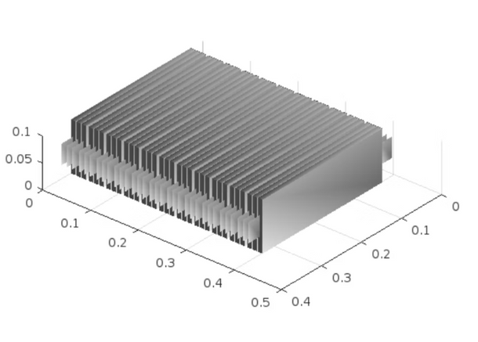
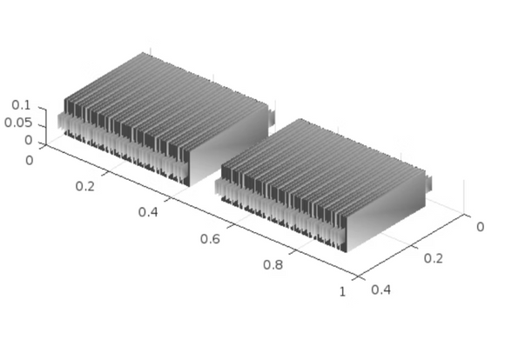
Battery Module
1
Series Connection
An 11-series configuration of the previously created parallel assemblies was implemented to form a complete battery module.
2
Inter-Assembly Gap
A precise inter-parallel assembly gap of 0.005 meters was introduced to facilitate thermal management and structural stability.
3
Structure Confirmation
The 'batteryChart' function was used to visually verify the accurate arrangement and spacing within the constructed module.
fig.3 Battery Module
fig.4 Module assembly

Slide 7
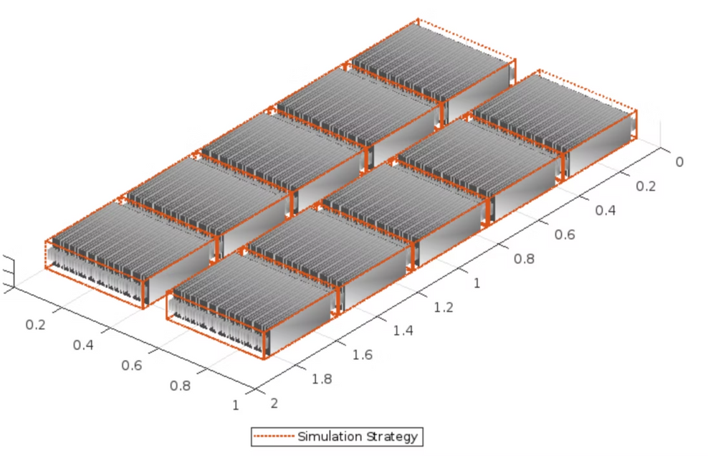
Module Assembly and Battery Pack
Module Repetition
The defined battery module was duplicated twice to create a module assembly, increasing the pack's overall voltage.
Pack Formation
Five such module assemblies were integrated to construct the full battery pack, ensuring desired energy capacity.
Structural Spacing
fig 5 Battey Pack
Appropriate spacing was incorporated between assemblies and modules to optimize thermal management and mechanical integrity.

Slide 8
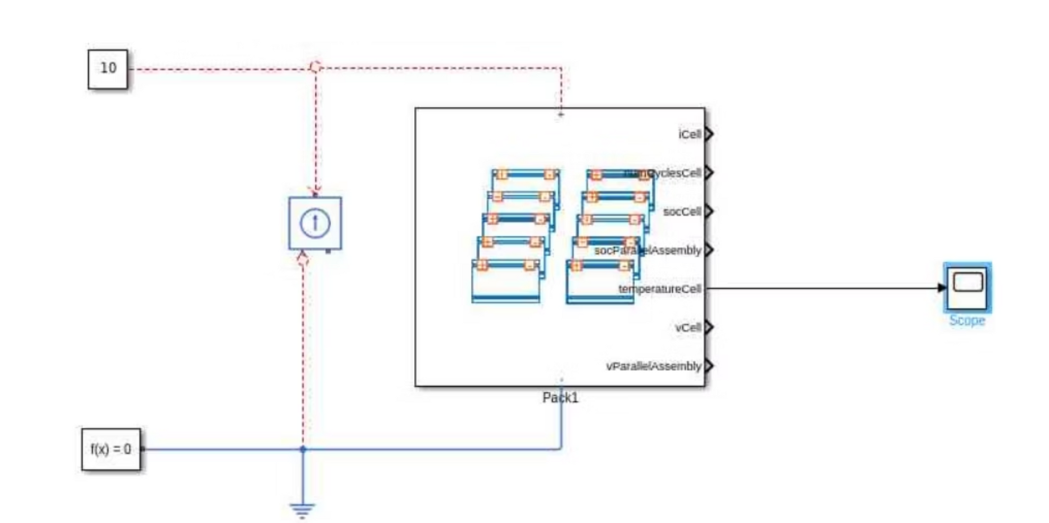
Simple Heat Generation Module

Slide 9
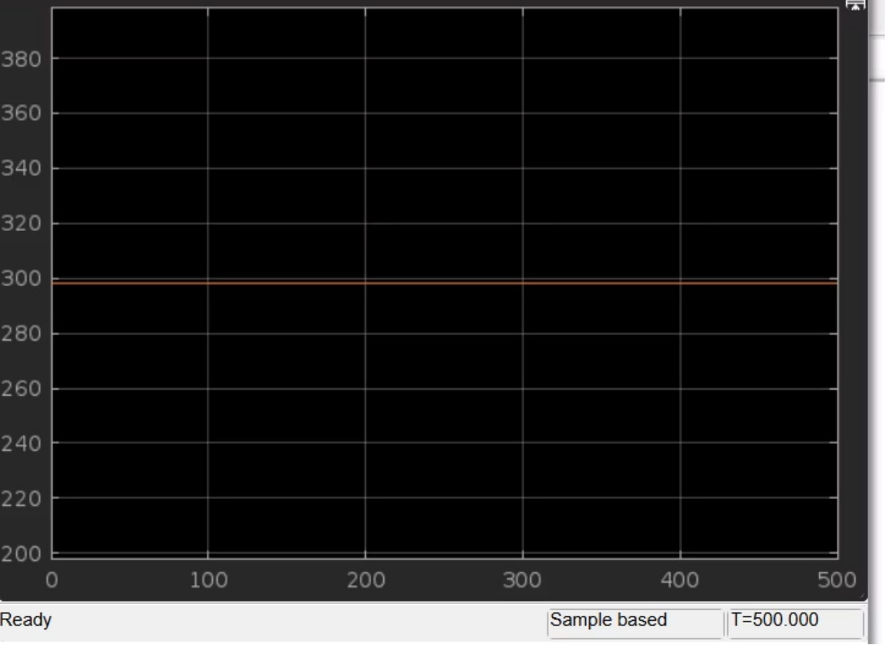
Simulation Results

Slide 10
CODE USED
>> import simscape.battery.builder.*
>> pouchGeometry = batteryPouchGeometry(simscape.Value(0.1,"m"), simscape.Value(0.3,"m"), TabLocation="Opposed");
>> pouchCell = batteryCell(pouchGeometry);
pouchCell.CellModelOptions.BlockParameters.thermal_port = "model";
f0 = figure(Name="Single Pouch Cell", Color="white");
batteryChart(f0, pouchCell);
>> parallelAssembly = batteryParallelAssembly(pouchCell, 3);
>> f1 = figure(Name="Parallel Assembly", Color="white");
batteryChart(f1, parallelAssembly);
>> module = batteryModule(parallelAssembly, 11, InterParallelAssemblyGap=simscape.Value(0.005,"m"));
>> f2 = figure(Name="Battery Module", Color="white");
batteryChart(f2, module);
>> moduleAssembly = batteryModuleAssembly(repmat(module,1,2), InterModuleGap=simscape.Value(0.1,"m"));
>> f3 = figure(Name="Module Assembly", Color="white");
batteryChart(f3, moduleAssembly);
>> pack = batteryPack(repmat(moduleAssembly,1,5), InterModuleAssemblyGap=simscape.Value(0.01,"m"));
>> f4 = figure(Name="Battery Pack", Color="white", Position=[0 0 1000 500]);
batteryChart(f4, pack, SimulationStrategyVisible="on");
>> buildBattery(pack, LibraryName="packLibraryBTM");

Slide 11

Current Progress Summary
1
Pack Structure Completion
The comprehensive battery pack structure, from cell to module to full assembly, has been successfully created and verified.
2
Basic Thermal Validation
Initial simulations have successfully validated the basic thermal behavior of the pack under load conditions.
3
Ready for Enhancements
The current model serves as a robust foundation for integrating advanced thermal management strategies and detailed analyses.

